Slide 1



CAPSTONE PROJECT
Mutual Fund Analytics Platform
PRESENTED BY: VASALA SHIVANI

Slide 2



Problem & Project Objective
The Challenges
The Solution
Fragmentation: Data spread across AMFI, mfapi.in, and NSE in multiple formats (TXT, PDF, HTML).
Automation: Python ETL automated ingestion of 10 primary datasets.
Analytics Gap: Investors lack risk-adjusted metrics like Sharpe, Alpha, and Beta for fund comparison.
Centralization: Standardized multi-source analytics normalized into a 5-table schema.
Static Reporting: Reliance on PDF reports rather than real-time interactive insights.
Interaction: Power BI delivery for live risk tracking and strategic decisions.

Slide 3

Data Sources & Datasets
Dataset Reference | Source Entity | Record Density | Primary Insight Dimension
01_fund_master | AMFI India | 40 Rows | Category, Risk Profile, Expense Ratio
02_nav_history | mfapi.in REST API | ~46,000 Rows | Daily NAV Sequence (2022-2026)
04_monthly_sip | AMFI Monthly Notes | 48 Rows | Active Accounts, Regional Split
08_investor_transactions | Simulated Ledger | ~32,000 Rows | Geo/Demographic Flows
10_benchmark_indices | NSE/BSE Public | ~8,000 Rows | Nifty 50, Nifty 100, SmallCap

Slide 4


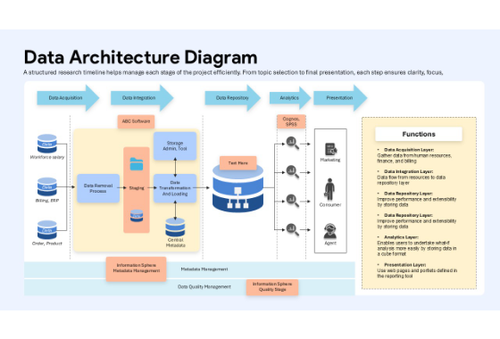
System Architecture & ETL
Extraction (Layer 1): Python scripts fetch Daily NAV via mfapi.in API and AMFI historical CSVs.
Transformation (Layer 2): Pandas normalizes names, calculates daily returns, and forward-fills holidays.
Storage (Layer 3): Loaded into localized SQLite schema (dim_fund, dim_date, fact_nav).
Analytics & BI (Layer 4): Real-time BI connection for executive-level dashboard reporting.

Slide 5
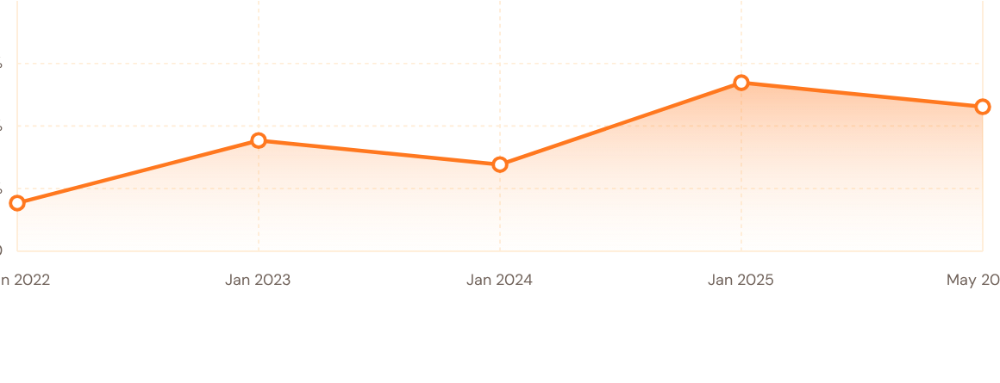
EDA: Historical NAV Trends
Unified performance overview of 40 active fund schemes spanning 4.5 operational years, validating solid historical market resilience and steady CAGR trends.

Slide 6


Market Proportions: Inflows
Geographic concentration reveals T30 retains dominant AUM share, though B30 regions depict a faster relative growth trajectory during the 2024-2025 period.

Slide 7

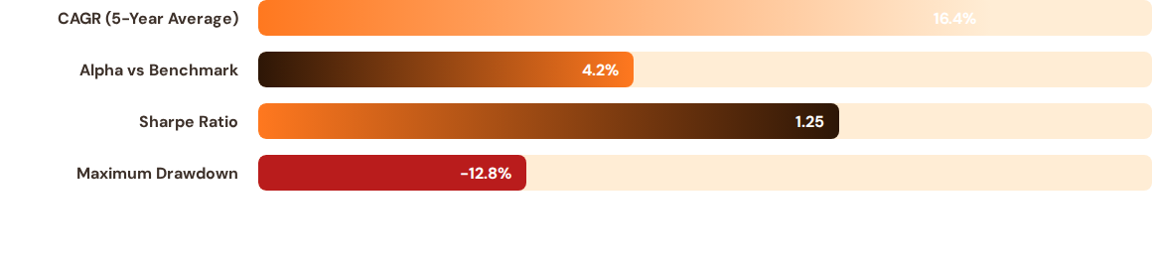
Risk-Return Metrics Comparison
Calculated returns against a simulated risk-free rate of 6.50% (RBI Repo rate proxy), validating robust risk-adjusted returns across major schemes.

Slide 8

Market Inflows & Scale
81L
Significant Milestone Reached
The total Assets Under Management reached historic proportions in December 2025, driven by unprecedented retail investor participation. The digital-first onboarding pipelines implemented across leading AMCs have triggered a democratization of systematic equity investments.
CRORE INDUSTRY AUM
Active systematic investment accounts expanded to an impressive 9.35 Crore folios during the Q4 period.

Slide 9

Industry Overview Dashboard
Executive Summary Slices
Designed with intuitive filter controls allowing managers to slice portfolio insights across fund houses, scheme classes, and asset categories.
Key indicators stream live AUM totals, SIP inflow trajectories, and demographic classifications with zero latency directly from SQL views.

Slide 10


Demographics & Interactive Flows
Investor Behaviours
Age Bracket Activity: The 26-35 age bracket remains the most prominent demographic registering for systematic SIP products.
Payment Channel: Dynamic UPI Mandate registrations accounted for 82% of newly recorded active accounts.
Geographic Expansion: Regional distribution heatmap exhibits strong emergence of Tier-2 and beyond market shares.
Risk-Return Distribution Analysis

Slide 11

Key Findings & Analytics Insights
Market Concentration: Top-3 AMCs (SBI, ICICI Prudential, and HDFC) actively command over 40% of standard industry equity AUM.
SIP Performance: Continuous monthly inflows exhibit highly inelastic characteristics relative to major short-term benchmark corrections.
Alpha Creation: Active Large-Cap schemes outperformed Nifty index benchmarks by an average alpha range of 2.1% to 4.5%.
Retention Trajectory: Systematic portfolios targeting direct plans recorded a 14% higher average tenure compared to regular mutual fund products.

Slide 12

Thank You
vasalashivani9@gmail.com
https://github.com/VasalaShivani

